Slide 1


NASA Space Apps Challenge
PROJECT DEMO
Community Mapping
PRESENTED BY:
Team TerraGrid

Slide 2
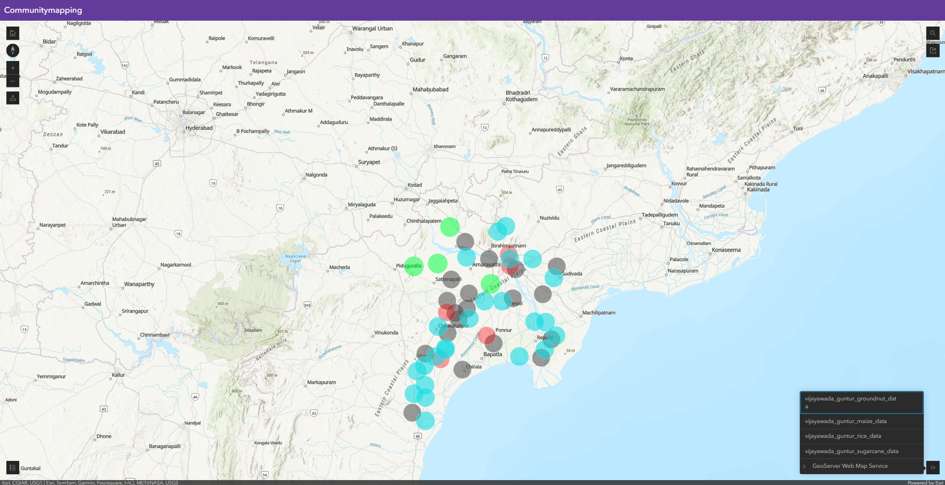
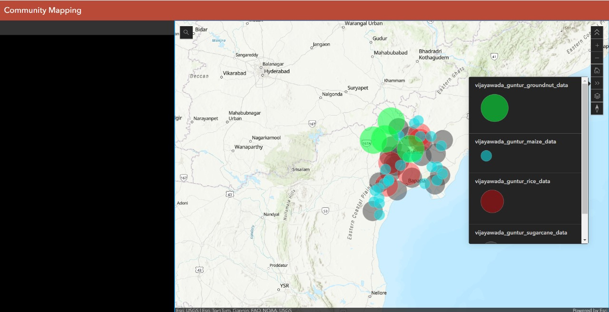
Home

Slide 3
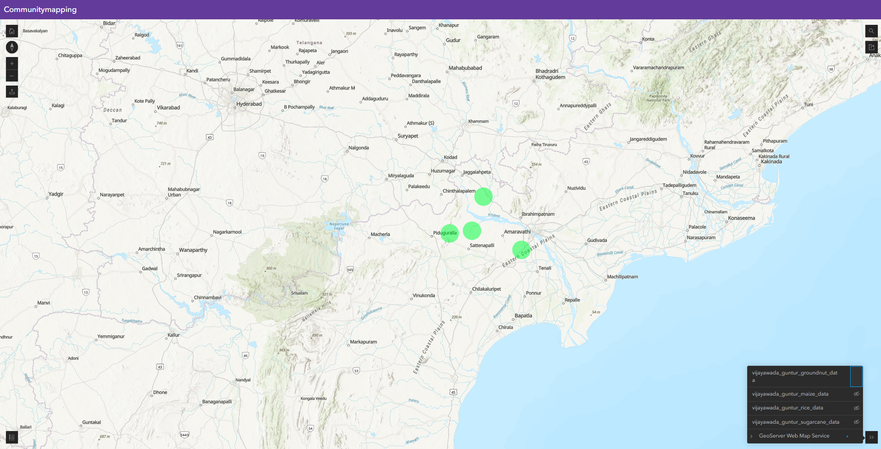
Layers

Slide 4
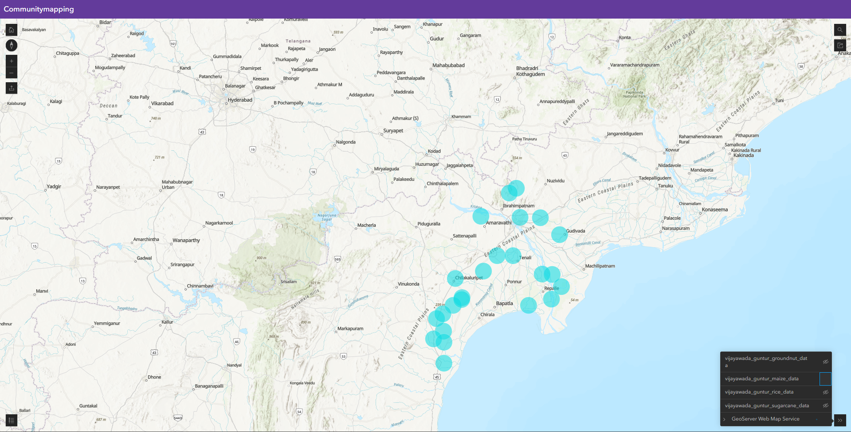
Layers

Slide 5
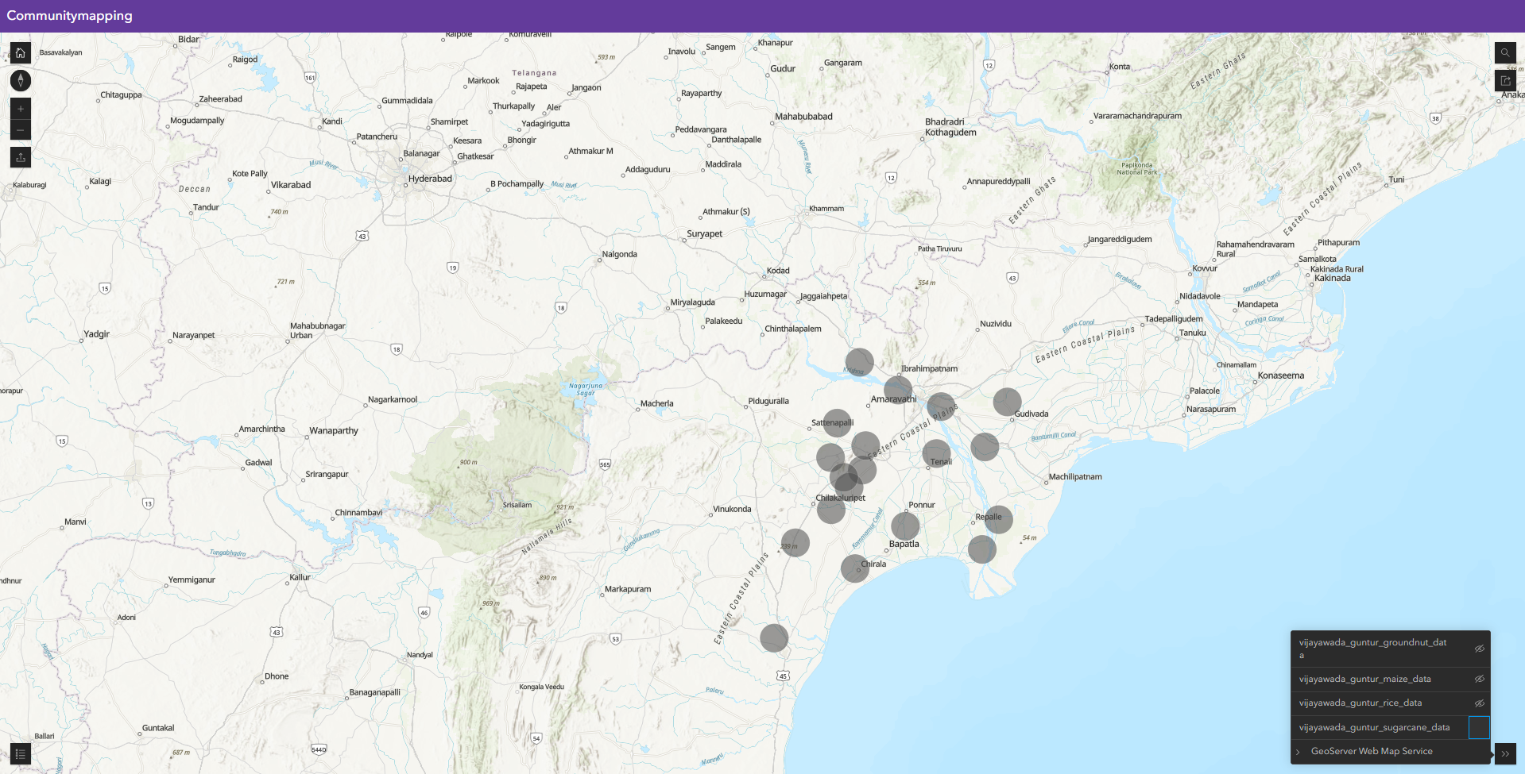
Layers

Slide 6
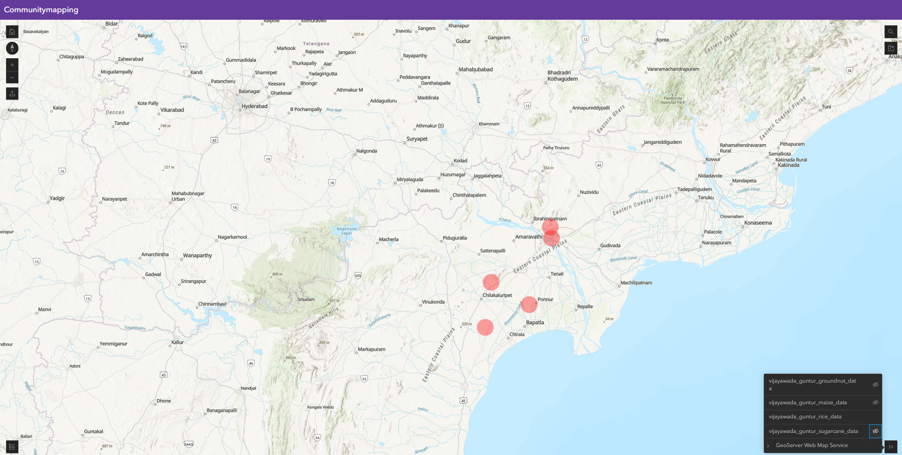
Layers

